Slide 1

Galgotias College of Engineering and Technology, Greater Noida
Posets, Hasse Diagram and Lattices and Boolean Algebra
Unit: 2
Discrete Mathematics
(KCA 104)
Aditya Narayan Singh
Assistant Professor
Department of MCA
MCA 1st Sem

Slide 2
Unit Objective
State the algebraic definition of a Boolean algebra.
The objective of unit 2 to solve problems using the algebraic properties of the elements of a Boolean algebra.
Define a poset and find the maximum and minimum elements of subsets of posets when they exist.
Find the supremum and infimum of subsets of posets when they exist.
Define a lattice and identify lattices among posets.

Slide 3
Topic Objective: Lattices(CO2)
Objective is to learn lattices are
To solve problems using the algebraic properties of the elements of a Boolean algebra.
define a poset and find the maximum and minimum elements of subsets of posets when they exist.
define a lattice and identify lattices among posets.
define and verify distributive property for lattices.
define a sublattice.
state the definitions of a bounded lattice and a complete lattice.
identify bounded and complete lattices.

Slide 4
Partially Ordered Sets(CO2)
Partial ordering: reflexive, anti-symmetric and transitive binary relation
Example: For S = {a,b,c}, partial ordering satisfies
Reflexive: a ≤ a
Anti-Symmetric: a ≤ b and b ≤ a imply a=b
Transitive: if a ≤ b and b ≤ c, then a ≤ c

Slide 5
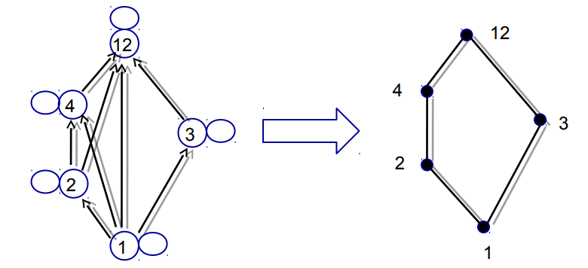
Partially Ordered Set(CO2)
Example: Let A={1,2,3,12} consider the partial order of divisibility on A. Draw the corresponding Hasse Daigram

Slide 6
Comparable(CO2)
If (A, ≤) is a poset, elements a and b of A are comparable if
a ≤ b or b ≤ a
In some poset, e.g. the relation of divisibility (a R b iff a | b), some pairs of elements are not comparable
2 | 7 and 7 | 2
Note: if every pair of elements in a poset A is comparable, we say that A is linear ordered set, and the partial order is called a linear order. We also say that A is a chain or totally ordered set.

Slide 7
Totally Ordered Sets(CO2)
Total ordering: if for every pair a,b in S, either a≤ b or b ≤ a , then S is totally ordered by binary relation
Example: Set of all prime numbers is totally ordered by ≤
Displaying the ordering relation with a Hasse diagram
Example: Partial ordering displaying divisibility relation among all positive divisors of 45, such that the quotient is an integer
Hasse diagram

Slide 8
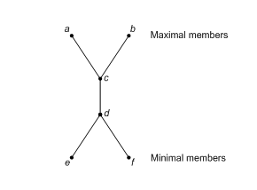
Extremal Elements of Partially Ordered Sets(CO2)
Consider a poset (A, ≤ )
Maximal Element An element a in A is called a maximal element of A if there is no element c in A such that a ≤ c.
Minimal Element An element b in A is called a minimal element of A if there is no element c in A such that c ≤ b.
An element a in A is a maximal (minimal) element of (A, ≥ ) if and only if a is a minimal (maximal) element of (A, ≤ )

Slide 9
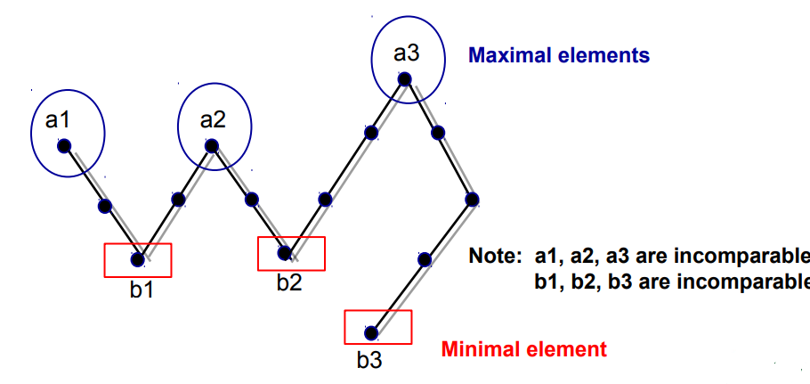
Extremal Elements of Partially Ordered Sets(CO2)
Example: Find the maximal and minimal elements in the following Hasse diagram

Slide 10
Extremal Elements of Partially Ordered Sets(CO2)
Example Let A be the poset of non negative real number with the usual partial order ≤ . Then 0 is a minimal element of A. There are no maximal elements of A.
Example The poset Z with the usual partial order ≤ has no maximal elements and has no minimal elements

Slide 11
Greatest element and Least element(CO2)
Greatest element:
An element a in A is called a greatest element of A if x ≤ a for all x in A.
Least element
An element a in A is called a least element of A if a ≤ x for all x in A.
Note: an element a of (A, ≤ ) is a greatest (or least) element if and only if it is a least (or greatest) element of (A, ≥ )

Slide 12
Extremal Elements of Partially Ordered Sets(CO2)
Unit element
The greatest element of a poset, if it exists, is denoted by 1 and is often called the unit element.
Zero element
The least element of a poset, if it exists, is denoted by 0 and is often called the zero element.

Slide 13
Theorem 1(CO2)
If (A, ≤ ) be a poset, then
If greatest element exists, then it is unique.
If least element exists, then it is unique.
Proof: Assume that there are two greatest elements of poset (A, ≤ ), say a and b.
Therefore, x ≤ a and x ≤ b, ∀ x ∈ A.
∴a ≤ b (b is greatest element)
and b ≤ a (a is greatest element)
∴by antisymmetric property, a = b.
Similarly, for least element.

Slide 14
Theorem 2(CO2)
Let (L,∨, ∧) be a lattice.
commutative law for join and meet: For a, b ∈ L,
a ∨ b = b ∨ a; a ∧ b = b ∧ a
2. Associative law for join and meet: For a, b, c ∈ L,
(a ∨ b) ∨ c = a ∨ (b ∨ c ); (a ∧ b) ∧ c = a ∧ (b ∧ c )
3. Absorption law for join and meet: For a, b ∈ L,
a ∨ (a ∧ b) = a ; a ∧ (a ∨ b) = a

Slide 15
Proof of Theorem 2(CO2)
Proof of 1:
Let a, b ∈ L,
a ∨ b = l.u.b.{a,b} = l.u.b.{b,a} = b ∨ a
a ∧ b = g.l.b.{a,b} = g.l.b.{b,a} = b ∧ a
Proof of 2:
Let a, b ∈ L,
b ≤ (a ∨ b) ≤ (a ∨ b) ∨ c and
c ≤ (a ∨ b) ∨ c
By def. of l.u.b., b ∨ c ≤ (a ∨ b) ∨ c
Also, a ≤ (a ∨ b) ≤ (a ∨ b) ∨ c
∴ a ∨ (b ∨ c ) ≤ (a ∨ b) ∨ c …(1)

Slide 16
Proof of Theorem 2(CO2)
Similarly, we have a ≤ a ∨ (b ∨ c ) and b ≤ b ∨ c ≤ a ∨ (b ∨ c )
By def. of l.u.b., we get a ∨ b ≤ a ∨ (b ∨ c )
Also, c ≤ b ∨ c ≤ a ∨ (b ∨ c )
Hence, (a ∨ b) ∨ c ≤ a ∨ (b ∨ c ) …(2)
Since, ‘≤’ is anti-symmetric, ∴from (1) and (2),
(a ∨ b) ∨ c = a ∨ (b ∨ c )
Similarly, we prove for meet: (a ∧ b) ∧ c = a ∧ (b ∧ c )

Slide 17
Proof of (3): Absorption law:(CO2)
Let a, b ∈ L,
Since, a ≤ a ∨ b
∴ a ∨ (a ∧ b) = a
Similarly, a ∧ b ≤ and
∴ a ∧ (a ∨ b) = a
E.g. In D₂₀, 2 ∨ (2 ∧ 4) = 2 ∨ (2) = 2
and 2 ∧ (2 ∨ 4) = 2 ∧ (4) = 2

Slide 18
Theorem 3: Let (L,∨, ∧) be a lattice(CO2).
Idempotent laws for join and meet: For a∈ L,
a ∨ a = a; a ∧ a = a; ∀ a∈ L
Proof: Let a∈ L,
a ∨ a = l.u.b.{a, a} = l.u.b.{a} = a
a ∧ a = g.l.b.{a, a} = g.l.b.{a} = a

Slide 19
Theorem 4:(CO2)
Let (L,∨, ∧) be a lattice.
Suppose the greatest element 1 and the least element 0 exist, then for x ∈ L, x ∨ 1 = 1; x ∧ 1 = x; x ∨ 0 = x; x ∧ 0 = 0
Proof: Let x∈ L, since 1 is the greatest element and 0 is the least element,
x ∧ 1 ≤ x and x ≤ x ; x ≤ 1
∴x = x ∧ x ≤ x ∧ 1
∴ x ∧ 1 = x
Similarly, we prove other properties.

Slide 20
Lower/Upper Bound of a Subset of Set S(CO2)
Consider a poset (A, ≤)
Upper bound of a and b:
An element c in A is called an upper bound of a and b if a ≤ c and b ≤ c for all a, b in A.
Least upper bound (lub): smallest of all upper bounds
Lower bound of a and b:
An element d in A is called a lower bound of a and b if d ≤ a and d ≤ b for all a, b in A
Greatest lower bound (glb): largest of all lower bounds
Example: S = {1,3,5,9,15,45} and P = {3,5}
Upper bounds: 15, 45 lub: 15 lb=1 glb = 1

Slide 21
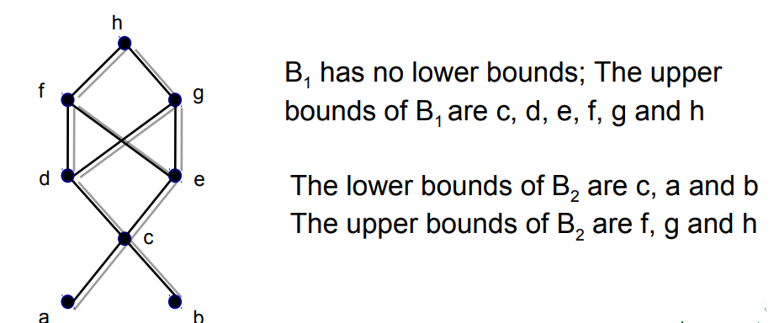
Lower/Upper Bound(CO2)
Example
Find all upper and lower bounds of the following subset of A: (a) B₁={a, b}; B₂={c, d, e}

Slide 22
Greatest Lower/Least Upper Bound(CO2)
Consider a poset (A, ≤), and a, b in A,
Least upper bound
An element c in A is called a least upper bound of a and b, if (i) c is an upper bound of a and b; i.e. a ≤ c & b ≤ c (ii) if c’ is another upper bound then c ≤ c’.
Greatest lower bound
An element g in A is called a greatest lower bound of a and b, if (i) g is a lower bound of a and b; i.e. g ≤ a & g ≤ b (ii) if g’ is another lower bound then g’ ≤ g.

Slide 23
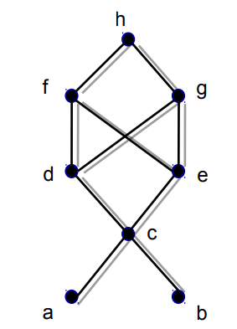
Greatest Lower/Least Upper Bound(CO2)
Example : Find all least upper bounds and all greatest lower bounds of (a) B1={a, b} (b) B2={c, d, e}
Since B1 has no lower bounds, it has no greatest lower bounds;
However, LUB(B1)=c
(b) Since the lower bounds of B2 are c, a and b,
we find that GLB(B2)=c The upper bounds
of B2 are f, g and h. Since f and g are not
comparable, we conclude that B2 has no
least upper bound.

Slide 24
Lattice(CO2)
Lattice: partially ordered set in which every pair of elements has a unique glb and a unique lub
LUB({a, b}) by a ∨ b (the join of a and b)
GLB({a, b}) by a ∧ b (the meet of a and b)
Least element: denoted as 0
Greatest element: denoted as 1
For each element a of lattice: a≤ 1 and 0≤a and
Example:
Lattice
Not a lattice

Slide 25
Lattice(CO2)
Example: Lattice of all subsets of set S = {a,b,c}, under the ordering relation of set inclusion, where {a,b,c} = 1 and ɸ = 0.

Slide 26
Lattice(CO2)
Example: consider the poset (Z⁺ , ≤), where for a and b in Z⁺ , a ≤ b if and only if a | b , then
a ∨ b = LCM(a, b)
a∧ b = GCD(a, b)
LCM: least common multiple
GCD: greatest common divisor

Slide 27
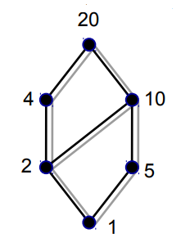
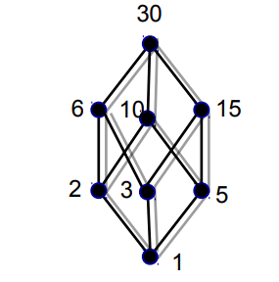
Lattice(CO2)
Example: Let n be a positive integer and D_{n} be the set of all positive divisors of n. Then D_{n} is a lattice under the relation of divisibility. For instance,
D₂₀= {1,2,4,5,10,20} D₃₀= {1,2,3,5,6,10,15,30}

Slide 28
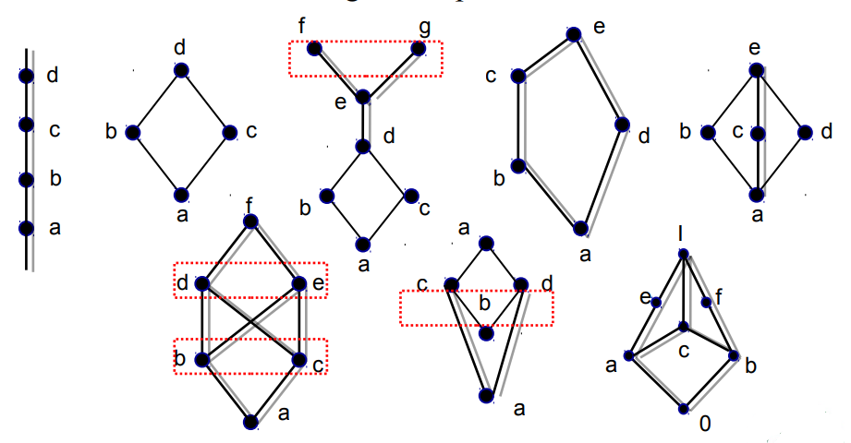
Lattice(CO2)
Example: Example 4 Which of the Hasse diagrams represent lattices?

Slide 29
Bounded Lattices(CO2)
Bounded
A lattice L is said to be bounded if it has a greatest element 1 and a least element 0
For instance:
Example: The lattice P(S) of all subsets of a set S, with the relation containment is bounded. The greatest element is S and the least element is empty set.
Example : The lattice Z⁺ under the partial order of divisibility is not bounded, since it has a least element 1, but no greatest element.

Slide 30
Distributive Lattices(CO2)
Distributive
A lattice (L, ≤) is called distributive if for any elements a, b and c in L we have the following distributive properties:
1. a ∧ (b ∨ c) = (a ∧ b) ∨ (a ∧ c)
2. a ∨ (b ∧ c) = (a ∨ b) ∧ (a ∨ c)
If L is not distributive, we say that L is non distributive.
Note: the distributive property holds when
a. any two of the elements a, b and c are equal or
b. when any one of the elements is 0 or I.

Slide 31
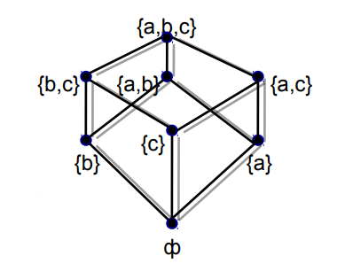
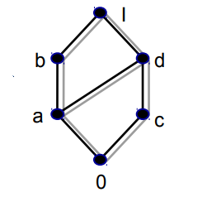
Distributive Lattices(CO2)
Example For a set S, the lattice P(S) is
distributive, since join and meet each
satisfy the distributive property.
Example The lattice whose Hasse
diagram shown in adjacent diagram
is distributive

Slide 32
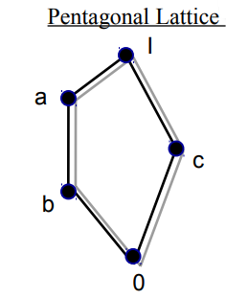
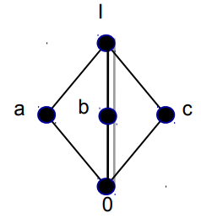
Distributive Lattices(CO2)
Example :Show that the lattices as follows are non-distributive.
a ∧ ( b ∨ c) = a ∧ I = a
(a∧ b) ∨(a ∧ c) = b ∨ 0 = b
a ∧ ( b ∨ c) = a ∧ I = a
(a∧ b) ∨ (a ∧ c) = 0 ∨ 0 = 0

Slide 33
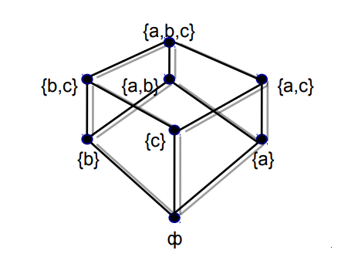
Modular Lattices(CO2)
A lattice (L, ≤) is called Modular if for any elements a, b and c in L if b ≤ a then b∨ (a∧ c) = a∧ (b ∨ c)
Example For a set S, the lattice P(S) is modular,
(if B ⊆ A) B ∪ (A ∩ C) = A ∩ (B ∪ C)

Slide 34
Example(CO2)
Every chain is a modular lattice
Example: Given Hasse diagram of a lattice which is modular
0 ≤ a i.e. taking b=0;
b ∨ (a ∧ c) = 0 ∨ 0 = 0
a ∧ (b ∨ c) = a ∧ c = 0

Slide 35
Complemented Lattice(CO2)
Complement of an element:
Let L be bounded lattice with greatest element 1 and least element 0, and let a in L.
An element b in L is called a complement of a if
a ∨ b = 1 and a ∧ b =0
Note: 0’ = 1 and 1’ = 0
Complemented Lattice:
A lattice L is said to be complemented if it is bounded and every element in it has a complement.

Slide 36
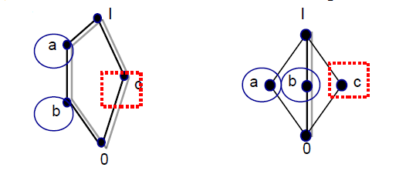
Complemented Lattice(CO2)
Example : The lattice L=P(S) is such that every element has a complement, since if A in L, then its set complement A has the properties A ∨ A = S and A ∧ A=ф. That is, the set complement is also the complement in L.
Example : complemented lattices where complement of element is not unique

Slide 37
Topic Objective: Boolean Algebra (CO2)
After learning Boolean algebra students will be able to Perform the three basic logic operations.
Describe the operation of and construct the truth tables for the AND, NAND, OR, and NOR gates, and the NOT (INVERTER) circuit.
Implement logic circuits using basic AND, OR, expression for the logic gates and combinations of logic gates. and NOT gates.
Appreciate the potential of Boolean algebra to simplify complex logic expressions.
Use De-Morgan’s theorems to simplify logic expressions.

Slide 38
Boolean Algebra(CO2)
An algebra which is use for simplifying the presentation & manipulation of propositional logic.
It is also known as Switching Algebra.
Invented by George Boole in 1854.
Boolean algebra is mainly use for simplify and manipulate electronic logic circuits in computers.

Slide 39
Basic concepts of Boolean algebra (CO2)
It is denoted by (B, +, ., ‘, 0, 1), where
B = non-empty set
+ is the binary operation denoting logical OR
. is the binary operation denoting logical AND
‘ is the unary operation denoting logical NOT
0 and 1 are distinct elements known as identity elements of + and . operation
It deals with the binary number system {0,1}.
Truth Table -It is a tabular representation of all the combination of values for input and their corresponding outputs.

Slide 40
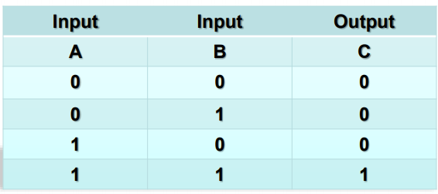
AND Operation(CO2)
AND operation is used for logical multiplication.
The dot symbol (“.”)used for representing AND operation.
AND operator has an output 1 if all the inputs are 1 otherwise the output is 0.
=A.B

Slide 41
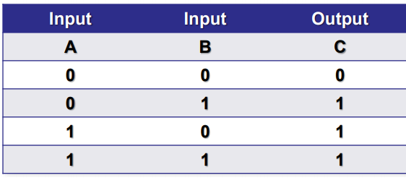
OR Operation(CO2)
OR operation is use for logical addition.
The symbol (“+”) used for represent OR operation.
OR operator has an output 0 if all of the inputs are 0 otherwise the output is 1.
=A+B

Slide 42
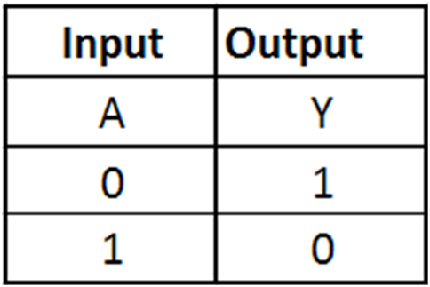
NOT operation (CO2)
NOT gate performs the logical complementation operation.
It is an electronic circuit that generates the reverse of the input signal as output signal.
=A’

Slide 43
Postulates/Axioms of Boolean Algebra (CO2)
If a, b, c ∈ B, then
Closure Law
a + b ∈ B ii. a.b ∈ B
Commutative Law
a + b = b + a ii. a.b = b.a
Distributive Law
a.(b + c) = a.b + a.c ii. a + (b.c) = (a + b).(a + c)
Identity Law
a + 0 = a ii. a.1 = a
Complement Law
a + a’ = 1 ii. a.a’ = 0

Slide 44
Postulates/Axioms of Boolean Algebra (CO2)
6. Idempotent Law
a + a = a ii. a.a = a
7. Boundedness Law
a + 1 = 1 ii. a.0 = 0
8. Absorption Law
a + a.b = a ii. a.(a + b) = a
9. Associative Law
a + (b + c) = (a + b) + c ii. a.(b.c) = (a.b).c

Slide 45
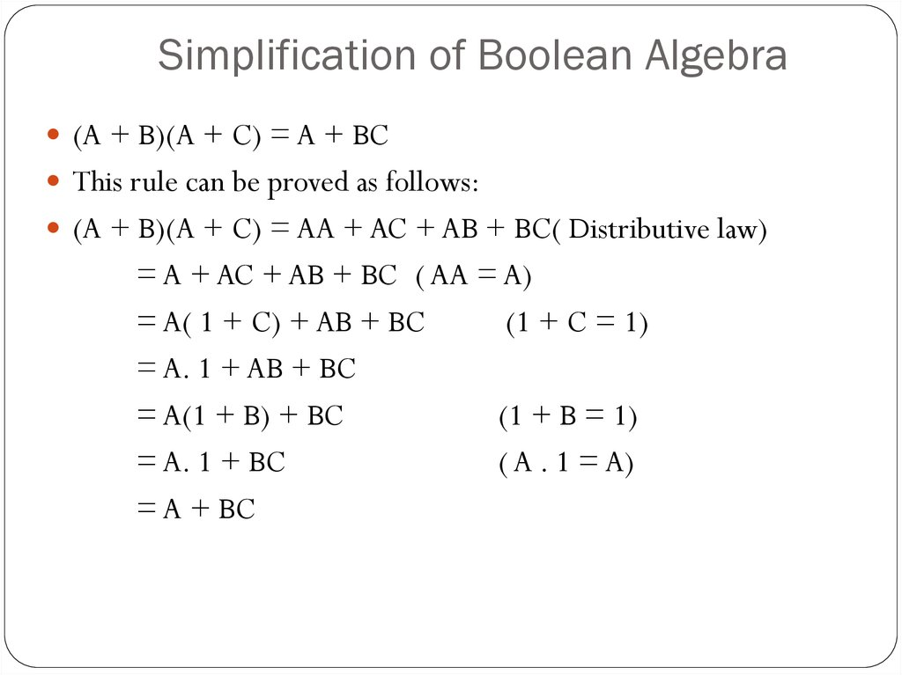
Minimization of Boolean Algebra using laws (CO2)
1.

Slide 46
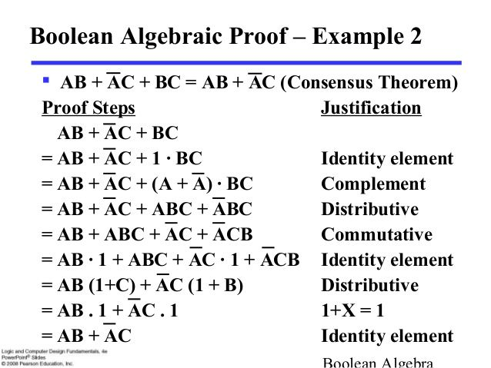
Minimization of Boolean Algebra using laws (CO2)
2.

Slide 47
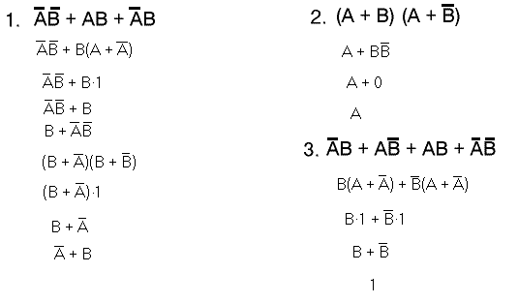
Minimization of Boolean Algebra using laws (CO2)
(Complement law)
(Identity Law)
(Complement law)
(Distributive law)
(Complement law)
(Identity law)
(Complement law)

Slide 48
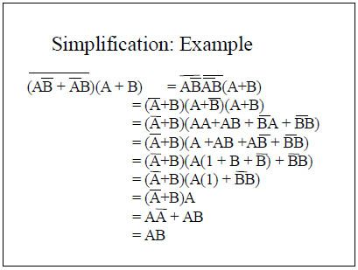
Other laws of Boolean Algebra (CO2)
If a, b, c ∈ B, then
1. Uniqueness of complement
If a + x = 1 and a.x = 0, then x = a’
2. Involution Law
(a’)’ = a
3. De-Morgan’s Law
(a + b)’ = a’.b’
(a.b)’ = a’ + b’

Slide 49
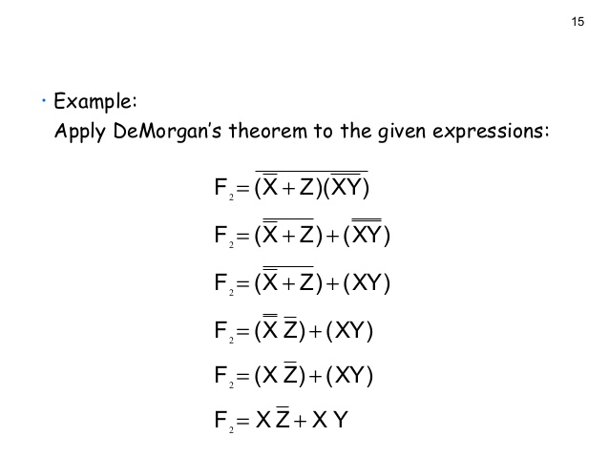
Example of De-Morgan Law(CO2)

Slide 50
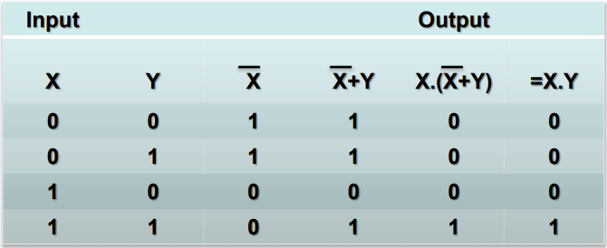
Boolean Function(CO2)
Boolean function is an expression formed with binary variable.
A boolean function is a specific boolean expression.
It is the combination of Boolean operators such as AND, OR & NOT operators.
The possible subscript/ expression can be named as F.
F= X.( X’+Y)=X.Y
Truth table for Boolean function.

Slide 51
Logic Gate (CO2)
Computer carries out all operations by the combination of signals that pass through standard blocks of built-in circuits.
Logic gate is an elementary building block of digital electronic circuits that operates one or more input signals to produce standard output.
The common use of logic gate elements is to act as switch.
In computer logic gates are used to implement Boolean functions.

Slide 52



Type of Logic Gates(CO2)
AND Gate
OR Gate
NOT Gate

Slide 53
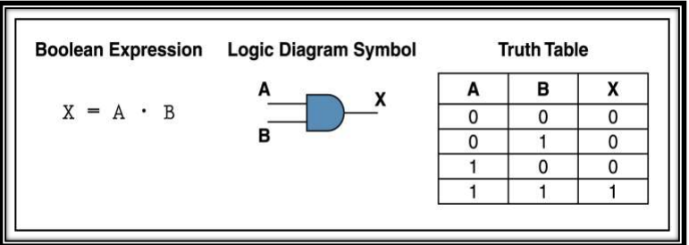
AND Gate(CO2)
AND gate is use for logical multiplication input signals.
If the input values for an AND gate are 1 then the output is 1
otherwise the output is 0.

Slide 54
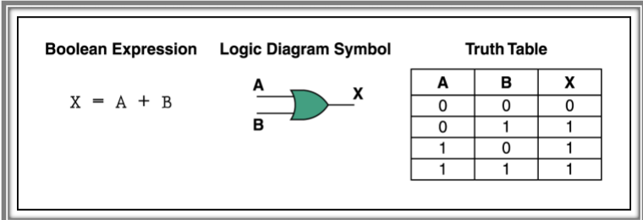
OR Gate(CO2)
OR gate performs the logical addition operation.
It is an electronic circuit that generates an output signal 1 if any of the input signal is 1.

Slide 55
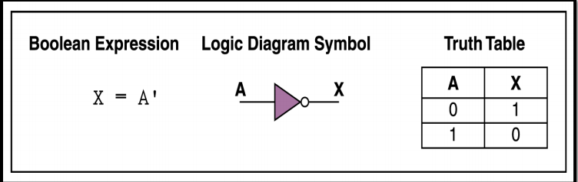
NOT Gate(CO2)
NOT gate performs the logical complementation operation.
It is an electronic circuit that generates the reverse of the input signal as output signal.

Slide 56
Simplification of Boolean Functions(CO2)
An implementation of a Boolean Function requires the use of logic gates.
A smaller number of gates, with each gate (other then Inverter) having less number of inputs, may reduce the cost of the implementation.
There are 2 methods for simplification of Boolean functions.

Slide 57
Simplification of Boolean Functions(CO2)
Two Methods
The algebraic method by using Identities
The graphical method by using Karnaugh Map method
The K-map method is easy and straightforward.
A K-map for a function of n variables
consists of 2^{n} cells, and,
in every row and column, two adjacent cells should differ in the value of only one of the logic variables.

Slide 58
Examples of K-Maps(CO2)
Examples:Cell numbers are written in the cells.
2-variable K-map
B
0
1
A
0
0 | 1
2 | 3
1

Slide 59
3-Variable K-Map:(CO2)
BC
00 01 11 10
A
0
1
0 | 1 | 3 | 2
4 | 5 | 7 | 6

Slide 60
4-variable K-map(CO2)
CD
00 01 11 10
AB
00
0 | 1 | 3 | 2
4 | 5 | 7 | 6
12 | 13 | 15 | 14
8 | 9 | 11 | 10
01
11
10

Slide 61
Simplification of boolean expressions using Karnaugh Map(CO2)
K-map takes both SOP and POS forms. So, there are two possible solutions for K-map, i.e., minterm and maxterm solution. Let's start and learn about how we can find the minterm and maxterm solution of K-map.
Minterm Solution of K Map
There are the following steps to find the minterm solution or K-map:
Step 1:
Firstly, we define the given expression in its canonical form.

Slide 62
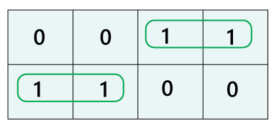
Simplification of boolean expressions using Karnaugh Map(CO2)
Step 2:
Next, we create the K-map by entering 1 to each product-term into the K-map cell and fill the remaining cells with zeros.
Step 3:
Next, we form the groups by considering each one in the K-map.

Slide 63
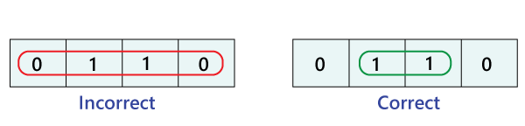
Simplification of boolean expressions using Karnaugh Map(CO2)
Notice that each group should have the largest number of 'ones'. A group cannot contain an empty cell or cell that contains 0.
In a group, there is a total of 2^{n} number of ones. Here, n=0, 1, 2, …n.

Slide 64
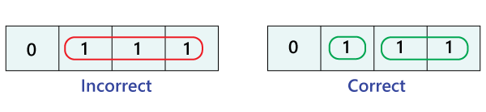
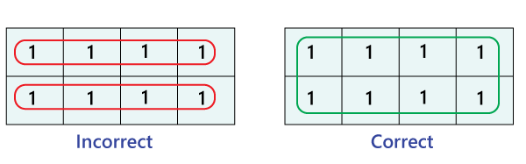
Simplification of boolean expressions using Karnaugh Map(CO2)

Slide 65
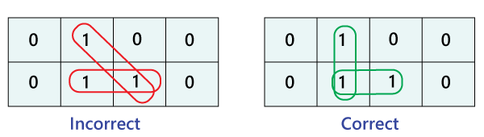
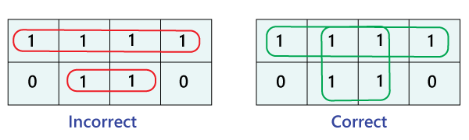
Simplification of boolean expressions using Karnaugh Map(CO2)

Slide 66
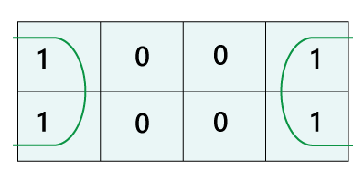
Simplification of boolean expressions using Karnaugh Map(CO2)
The elements located at the edges of the table are considered to be adjacent. So, we can group these elements.

Slide 67
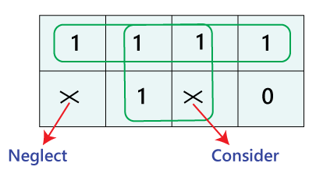
Simplification of boolean expressions using Karnaugh Map(CO2)
We can consider the 'don't care condition' only when they aid in increasing the group-size. Otherwise, 'don't care' elements are discarded.

Slide 68
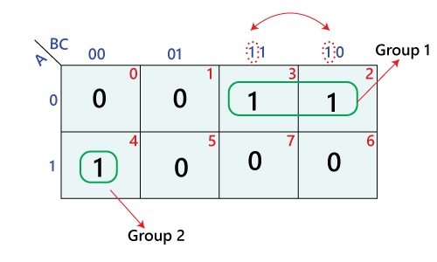
Simplification of boolean expressions using Karnaugh Map(CO2)
Step 4:
Step 5:
A’B + AB'C'

Slide 69
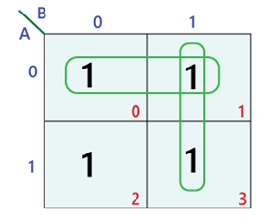

Simplification of boolean expressions using Karnaugh Map(CO2)
Example 1: Y=A'B' + A'B+AB
Simplified expression: Y=A'+B

Slide 70
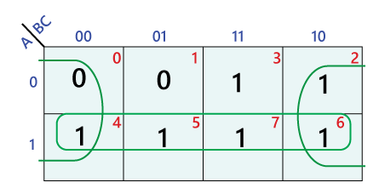

Simplification of boolean expressions using Karnaugh Map(CO2)
Example 2: Y=A'B'C'+A' BC'+AB' C'+AB' C+ABC'+ABC
Simplified expression: Y=A+C'

Slide 71
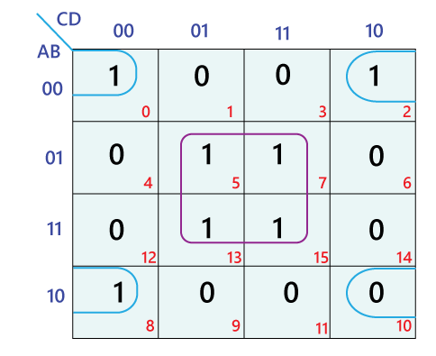
Simplification of boolean expressions using Karnaugh Map(CO2)
Example 3: Y=A'B'C' D'+A' B' CD'+A' BCD'+A' BCD+
AB' C'D'+ABCD'+ABCD
Simplified expression: Y=BD+B'D'

Slide 72
Literal, minterm of n variable(CO2)
Literal:
A variable or its complement is called a literal.
Minterm of n variable:
A product of n literals
in which each variable appears exactly once, in either its true or its complemented form, but not in both, and,
which is equal to 1 for exactly one combination of values of the n variables.

Slide 73
Maxterms (continued):(CO2)
For every K-map, each cell has one Maxterm
associated with it.
Thus, for cell no.13 in the 4-variable K-map,
M₁₃ = A’ + B’ + C + D’
By De Morgan’s theorem,
m_{i} = M_{i}’
ADJACENT minterms (Maxterms):
Minterm which are identical, except for one variable, are considered to be adjacent to one another.
In a K-map, the corresponding cells are said to be adjacent cells.

Slide 74
Adjacent minterms:(CO2)
Thus in K-4,
Cell O is adjacent to cells 1, 4, 2 and 8.
In a K-map, the corresponding cells in the top and the bottom rows are adjacent to each other.
Similarly the corresponding cells in the leftmost column and the rightmost column are adjacent to each other.

Slide 75
Daily Quiz(CO2)
A Poset in which every pair of elements has both a least upper bound and a greatest lower bound is termed as _______ a) sublattice b) lattice c) trail d) walk
In the poset (Z⁺, |) (where Z⁺ is the set of all positive integers and | is the divides relation) are the integers 9 and 351 comparable? a) comparable b) not comparable c) comparable but not determined d) determined but not comparable
If every two elements of a poset are comparable then the poset is called ________ a) sub ordered poset b) totally ordered poset c) sub lattice d) semigroup
What are the canonical forms of Boolean Expressions? a) OR and XOR b) NOR and XNOR c) MAX and MIN d) SOM and POM
______ and _______ are the two binary operations defined for lattices. a) Join, meet b) Addition, subtraction c) Union, intersection d) Multiplication, modulo division

Slide 76
Daily Quiz(CO2)
6. A ________ has a greatest element and a least element which satisfy 0<=a<=1 for every a in the lattice(say, L). a) semilattice b) join semilattice c) meet semilattice d) bounded lattice
7. Which of the following is/are the universal logic gates? a) OR and NOR b) AND c) NAND and NOR d) NOT
8. In boolean algebra, the OR operation is performed by which properties? a) Associative properties b) Commutative properties c) Distributive properties d) All of the Mentioned
9. The expression for Absorption law is given by _________ a) A + AB = A b) A + AB = B c) AB + AA’ = A d) A + B = B + A
10. According to boolean law: A + 1 = ? a) 1 b) A c) 0 d) A’

Slide 77

Daily Quiz(CO2)
11. A(A + B) = ? a) AB b) 1 c) (1 + AB) d) A
12. DeMorgan’s theorem states that _________ a) (AB)’ = A’ + B’ b) (A + B)’ = A’ * B c) A’ + B’ = A’B’ d) (AB)’ = A’ + B
13. The involution of A is equal to _________ a) A b) A’ c) 1 d) 0
14. (A + B)(A’ * B’) = ? a) 1 b) 0 c) AB d) AB’
15. Complement of the expression A’B + CD’ is _________ a) (A’ + B)(C’ + D) b) (A + B’)(C’ + D) c) (A’ + B)(C’ + D) d) (A + B’)(C + D’)

Slide 78
Daily Quiz(CO2)
16. K-map is used for _______ a) logic minimization b) expression maximization c) summing of parity bits d) logic gate creation
17. Simplify the expression using K-maps: F(A,B,C,D)=Σ (1,3,5,6,7,11,13,14). a) AB+BC’D+A’B’C b) BCD’+A’C’D+BD’ c) A’D+BCD+A’BC+AB’C’ d) AC’D’+BC+A’BD+C’D’
18. When designing a circuit to emulate a truth table, both Product-of-Sums (POS) expressions and Sum-of-Products (SOP) expressions can be derived from? a) k-map b) NAND gate c) NOR gate d) X-NOR gate
19. Simplify the expression using K-maps: F(A,B,C) = Σ (1,3,5,6,7). a) AC’+B’ b) AB+C c) AB’+B’C’ d) A’BC+B’C+AC
20. Simplify the expression using K-maps: F(A,B,C) = π(0,2,4,5,7). a) (x+y)(y+z)(x+z)(x’+z’) b) (x+z’)(y+z)(x+y) c) (x+y’+z)(x+z’) d) (y’+z’)(x’+y)(z+y’)

Slide 79
Weekly Assignment(CO2)
Define Isomorphism. Let A = {1, 2, 3, 6} and let ‘≤’ be the divisibility relation on A. Let B = {ϕ, {a}, {b}, {a,b}} and let ‘≤’ be the relation ⊆. Then (A, ≤ ) and (B, ≤) are isomorphic.
Consider the subset {2,3} {4,6} and {3,6}, and ({1,2,3,4,5,6}, / ) is the poset.
i) Draw the Hasse Diagram.
ii) Find the Lower bound and Upper bound of each subset if it exists.
iii) Find GLB and LUB of each subset if it exists.
3. Consider the Boolean function F(x1,x2,x3,x4)= x1+(x2.(x1’+x4)+x3.(x2’+x4’))
i) Simplify f algebraically
ii) Draw the logic circuit of f and reduction of f.

Slide 80
Weekly Assignment(CO2)
4. In a lattice if a ≤b≤c then prove that
a) a v b = b ∧ c
b) (a v b) v (b ∧ c) =(a v b) ∧ (a v c) = b
5. Draw the hasse diagram for (D₂₄, /).
6. Draw the Hasse diagram of Poset ({{1},{2},{4},{1,2}{1,4},{2,4},{3,4},{1,3,4},{2,3,4}}, ⊆) where composition is usual subset.
Draw the K-Map and simplify the following Boolean expressions:
i) ABC+ A’BC’+ABC’+A’BC
ii) A’B’C+A’B’C’+ABC’+ABC’+A’BC’
iii) AB’C’+ABC’+ABC+AB’C+AB’C’
iv) ABC’D’+AB’C’D’+AB’C’D+AB’C’D

Slide 81
Topic Links
Youtube/other Video Links
https://www.youtube.com/watch?v=qPtGlrb_sXg&list=PL0862D1A947252D20&index=40 CO2
https://www.youtube.com/watch?v=WW7YO0b4QHs&list=PLEAYkSg4uSQ2Wfc_l4QEZUSRdx2ZcFziO CO2

Slide 82
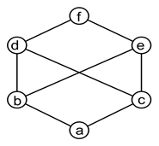
MCQs(CO2)
A sublattice(say, S) of a lattice(say, L) is a convex sublattice of L if _________ a) x>=z, where x in S implies z in S, for every element x, y in L b) x=y and y<=z, where x, y in S implies z in S, for every element x, y, z in L c) x<=y<=z, where x, y in S implies z in S, for every element x, y, z in L d) x=y and y>=z, where x, y in S implies z in S, for every element x, y, z in L
The graph is the smallest non-modular lattice N₅. A lattice is _______ if and only if it does not have a _______ isomorphic to N₅. a) non-modular, complete lattice b) moduler, semilattice c) non-modular, sublattice d) modular, sublattice
Every poset that is a complete semilattice must always be a _______ a) sublattice b) complete lattice c) free lattice d) partial lattice
The graph given below is an example of _________
a) non-lattice poset b) semilattice c) partial lattice d) bounded lattice

Slide 83
MCQs(CO2)
5. A free semilattice has the _______ property. a) intersection b) commutative and associative c) identity d) universal
6. Algebra of logic is termed as ______________ a) Numerical logic b) Boolean algebra c) Arithmetic logic d) Boolean number
7. Boolean algebra can be used ____________ a) For designing of the digital computers b) In building logic symbols c) Circuit theory d) Building algebraic functions
8. Which of the following relation is a partial order as well as an equivalence relation? a) equal to(=) b) less than(<) c) greater than(>) d) not equal to(!=)
9. The relation ≤ is a partial order if it is ___________ a) reflexive, antisymmetric and transitive b) reflexive, symmetric c) asymmetric, transitive d) irreflexive and transitive

Slide 84
MCQs(CO2)
10. What is the definition of Boolean functions? a) An arithmetic function with k degrees such that f:Y–>Y^{k} b) A special mathematical function with n degrees such that f:Y^{n}–>Y c) An algebraic function with n degrees such that f:X^{n}–>X d) A polynomial function with k degrees such that f:X²–>X^{n}
11. F(X,Y,Z,M) = X`Y`Z`M`. The degree of the function is ________ a) 2 b) 5 c) 4 d) 1
12. K-map is used for _______ a) logic minimization b) expression maximization c) summing of parity bits d) logic gate creation
13. In which of the following relations every pair of elements is comparable? a) ≤ b) != c) >= d) ==
14. In a poset P({v, x, y, z}, ⊆) which of the following is the greatest element? a) {v, x, y, z} b) 1 c) ∅ d) {vx, xy, yz}

Slide 85
MCQs(CO2)
15. Let D₃₀ = {1, 2, 3, 4, 5, 6, 10, 15, 30} and relation I be partial ordering on D₃₀. The all lower bounds of 10 and 15 respectively are
A. 1,3 B. 1,5
C. 1,3,5 D. None of these
16. Hasse diagrams are drawn for
A. partially ordered sets B. lattices
C. boolean Algebra D. none of these
17. A self-complemented, distributive lattice is called
A. Boolean algebra B. Modular lattice
C. Complete lattice D. Self dual lattice
18. Simplify Y = AB’ + (A’ + B)C. a) AB’ + C b) AB + AC c) A’B + AC’ d) AB + A
19. The boolean function A + BC is a reduced form of ____________ a) AB + BC b) (A + B)(A + C) c) A’B + AB’C d) (A + C)B
20. Use Karnaugh map to find the simplified expression of the function: F = x’yz + xy + xy’z’. a) xz’+y’z’ b) xy’z+xy c) y’z+x’y+z d) yz+xy+xy’z

Slide 86
Glossary Questions(CO2)
1). A Poset in which every pair of elements has both a least upper bound and a greatest lower bound is termed as _______
2). If every two elements of a poset are comparable then the poset is called ________ 3). ______ and _______ are the two binary operations defined for lattices.
4). A ________ has a greatest element and a least element which satisfy 0<=a<=1 for every a in the lattice(say, L).
5). Every poset that is a complete semilattice must always be a _______
6). A free semilattice has the _______ property.
7). F(X,Y,Z,M) = X`Y`Z`M`. The degree of the function is ________
8). A ________ value is represented by a Boolean expression.
9). The ___________ of all the variables in direct or complemented from is a maxterm.
10). The logic gate that provides high output for same inputs ____________

Slide 87
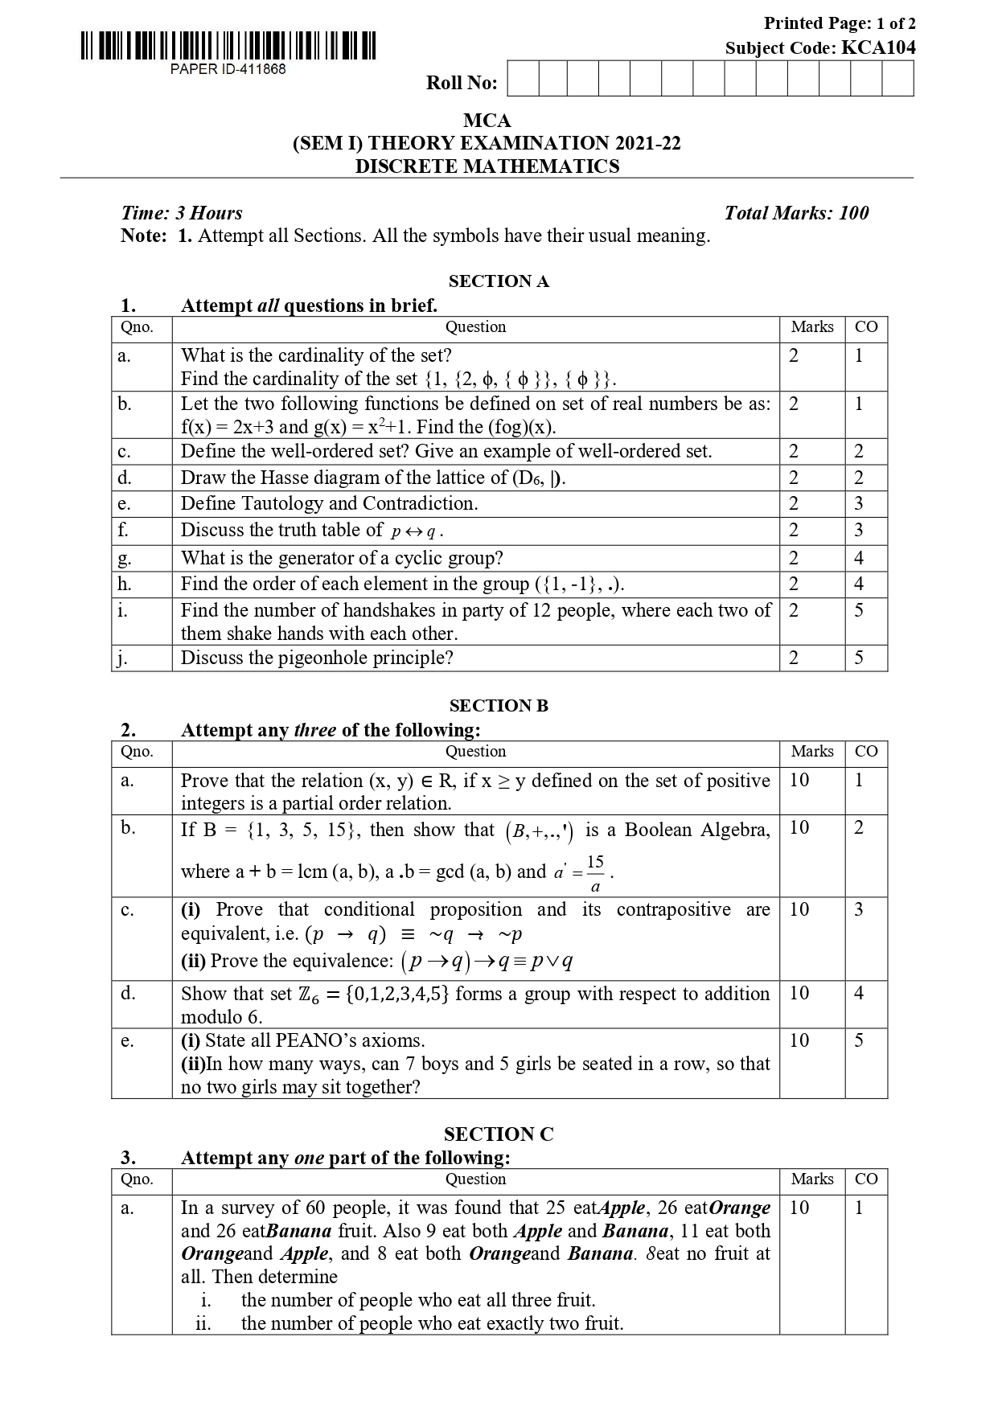
Old Question Papers (CO2)

Slide 88
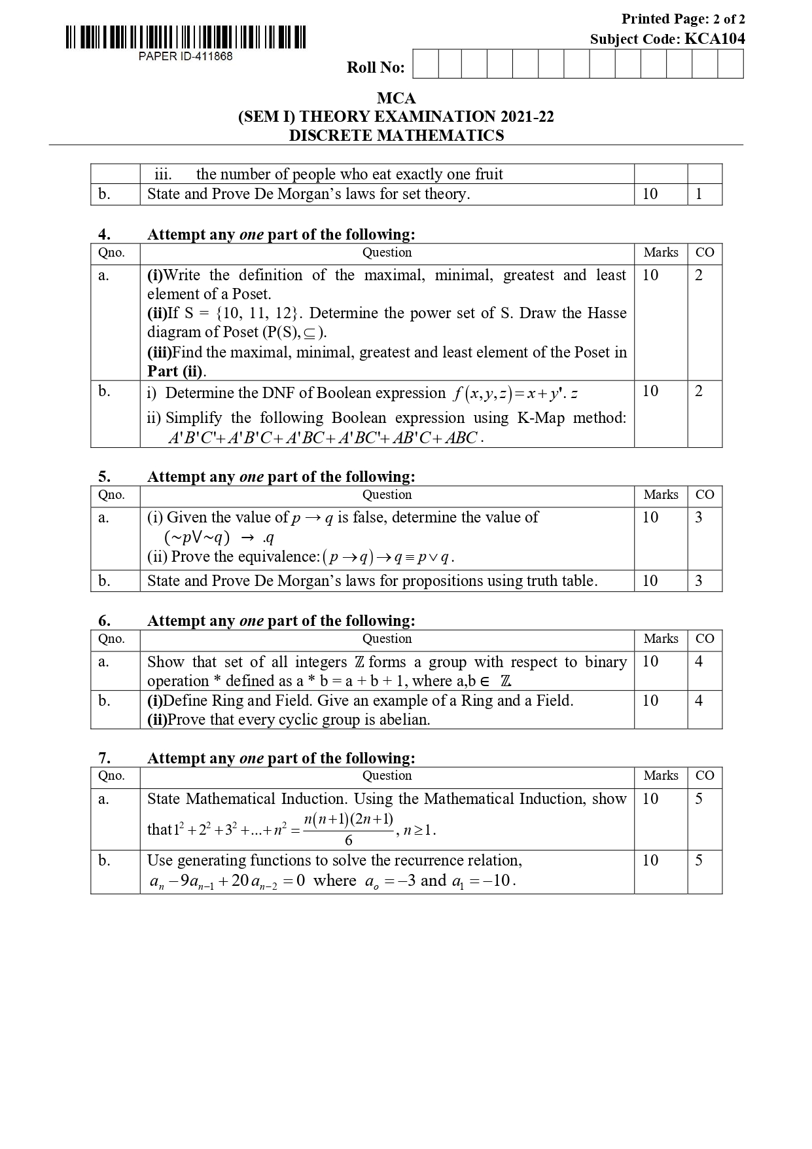
Old Question Papers (CO2)

Slide 89
Expected Questions for University Exam (CO2)
Draw the hasse diagram for (D₂₄, /).
Draw the Hasse diagram of Poset ({{1},{2},{4},{1,2}{1,4},{2,4},{3,4},{1,3,4},{2,3,4}}, ⊆)
3. In a lattice if a ≤b≤c then prove that
a) a v b = b ∧ c
b) (a v b) v (b ∧ c) =(a v b) ∧ (a v c) = b
4. What is Hasse diagram. Give example.
Let (A, ≤) and (B, ≤) be two posets. Prove that (A × B, ≤) is a poset,
where (a, b) ≤ (c, d) if and only if a ≤ c, b ≤ d.
6. Draw Karnaugh map and simplify the Boolean expression: -
A’B’C’D’+ A’B C’ D + A’ B’ C D + A’B’C D’ + A’B C D
7. Prove that a lattice with 5 elements is not a boolean algebra.
8. Show that the following are equivalent in a Boolean algebra
a ≤ b⇔ a*b' = 0⇔b' ≤ a ⇔ a’⊕ b' = 1

Slide 90
Expected Questions for University Exam (CO2)
9. Let (L,∨,∧,≤) be a distributive lattice and a,b∈ L . if a ∧ b = a ∧ c and
a ∨ b = a ∨ c then show that b = c
10. For any positive integer D₃₆, then find whether (D₃₆,’|’) is lattice or not?
11. Simplify the following Boolean function using K-map:
F(x,y,z)=Σ(0,2,3,7)
12. Explain Modular lattice, distribute lattice and bounded lattice with eg and diagram
13. Draw the Hasse diagram of (A, ≤), where A= {3,4,12,24,48,72} and relation ≤ be such that a ≤ b if a divides b
14. Find the values of the Boolean function represented by F (x, y, z) = xy + z’.
15. Draw Karnaugh map and simplify the Boolean expression: -
A’B’C’D’+ A’B C’ D + A’ B’ C D + A’B’C D’ + A’B C D
16. Let (A, ≤) and (B, ≤) be two posets. Prove that (A × B, ≤) is a poset,
where (a, b) ≤ (c, d) if and only if a ≤ c, b ≤ d.

Slide 91
Expected Questions for University Exam (CO2)
17. Simplify the following Boolean function using K-map:
F(x,y,z)=Σ(0,2,3,7)
18. Let (L,∨,∧,≤) be a distributive lattice and a,b∈ L . if a ∧ b = a ∧ c and
a ∨ b = a ∨ c then show that b = c
19. Answer these questions for the poset({3, 5, 9, 15,24, 45}, |).
i. Find the maximal elements.
ii. Find the minimal elements.
iii. Is there a greatest element?
iv. Is there a least element?
v. Find all upper bounds of {3, 5}.
vi. Find the least upper bound of {3, 5}.
vii. Find all lower bounds of {15, 45}.
Viii. Find the greatest lower bound of {15, 45},if it exists.

Slide 92
Recap of Unit (CO2)
Now you were able to understand the concepts discrete structures include sets, relation , functions, Algebraic Structure, poset, lattice, Boolean algebra etc.
A lattice is an abstract structure studied in the mathematical sub-disciplines of order theory and abstract algebra. It consists of a partially ordered set in which every two elements have a unique supremum (also called a least upper bound or join) and a unique infimum (also called a greatest lower bound or meet).
Boolean algebra simplifies logic circuits to increase work efficiency of digital device.

Slide 93
Recap of Unit (CO2)
Logic circuits can be built for any binary electric or electronic devices including switches, relays, electron tubes and transistors.
After learning the lattices students will be able to use lattice in Page Rank of Google and measure the similarity of two orderings (ranking) on a set, i.e. Pearson correlation.
The subject enhances one’s ability to develop logical thinking and ability to problem solving.

Slide 94
References
B. Kolman, R.C. Busby, and S.C. Ross, Discrete Mathematical Structures, 5/e, Prentice Hall, 2004.
Liptschutz, Seymour, “ Discrete Mathematics”, McGraw Hill.
Trembley, J.P & R. Manohar, “Discrete Mathematical Structure with Application to Computer Science”, McGraw Hill
Koshy, Discrete Structures, Elsevier Pub. 2008 Kenneth H. Rosen, Discrete Mathematics and Its Applications, 6/e, McGraw-Hill, 2006.

Slide 95
Thank You

